Slide 1
Chapter 4
Identifying and Selecting Systems Development Projects

Slide 2
Learning Objectives
Describe the project identification and selection process.
Describe corporate strategic planning and information systems planning process.
Explain the relationship between corporate strategic planning and information systems planning.
Describe how information systems planning can be used to assist in identifying and selecting systems development projects.
Chapter 4
Copyright © 2014 Pearson Education, Inc. Publishing as Prentice Hall

Slide 3
Learning Objectives (Cont.)
Analyze information systems planning matrices to determine affinity between information systems and IS projects and to forecast the impact of IS projects on business objectives.
Describe the three classes of Internet electronic commerce applications: business-to-consumer, business-to-employee, and business-to-business.
Chapter 4
Copyright © 2014 Pearson Education, Inc. Publishing as Prentice Hall

Slide 4
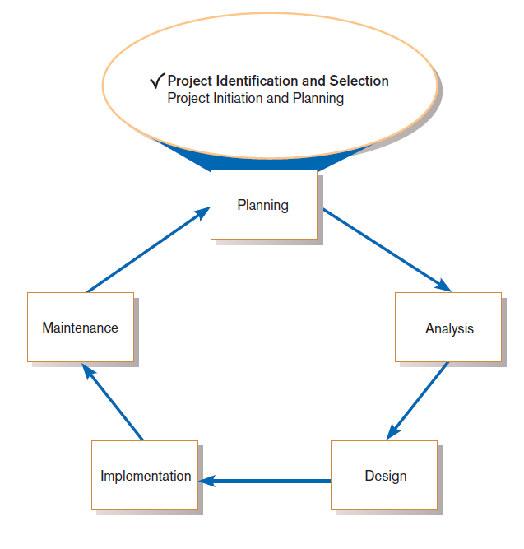
Identifying and Selecting Systems Development Projects
FIGURE 4-1
Systems development life cycle with
project identification and selection
highlighted
Three main steps:
Identifying potential development projects
Classifying and ranking IS development projects
Selecting IS development projects
Chapter 4
Copyright © 2014 Pearson Education, Inc. Publishing as Prentice Hall

Slide 5
The Process of Identifying and Selecting IS Development Projects
Identifying potential development projects
  Identification from a stakeholder group
    Each stakeholder group brings their own perspective and motivation to the IS decision.
Chapter 4
Copyright © 2014 Pearson Education, Inc. Publishing as Prentice Hall

Slide 6
The Process of Identifying and Selecting IS Development Projects (Cont.)
  Top-down source are projects identified by top management or by a diverse steering committee.
  Bottom-up source are project initiatives stemming from managers, business units, or the development group.
  The process varies substantially across organizations.
Chapter 4
Copyright © 2014 Pearson Education, Inc. Publishing as Prentice Hall

Slide 7
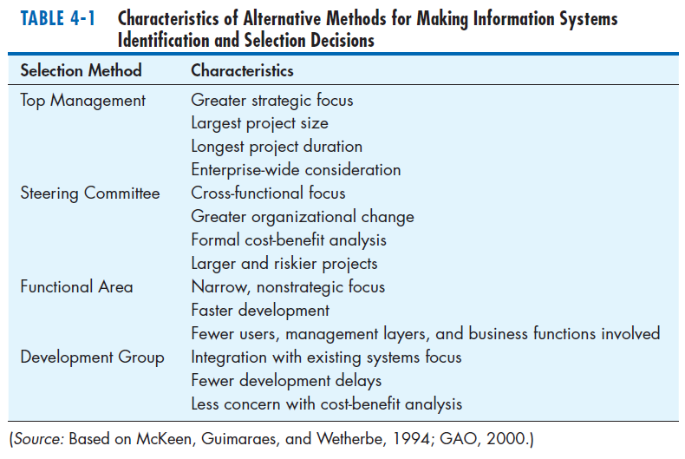
The Process of Identifying and Selecting IS Development Projects (Cont.)
Chapter 4
Copyright © 2014 Pearson Education, Inc. Publishing as Prentice Hall

Slide 8
The Process of Identifying and Selecting IS Development Projects (Cont.)
Classifying and ranking IS development projects
  Using value chain analysis or other evaluation criteria
Value chain analysis: Analyzing an organization’s activities to determine where value is added to products and/or services and the costs incurred for doing so; usually also includes a comparison with the activities, added value, and costs of other organizations for the purpose of making improvements in the organization’s operations and performance
Chapter 4
Copyright © 2014 Pearson Education, Inc. Publishing as Prentice Hall

Slide 9
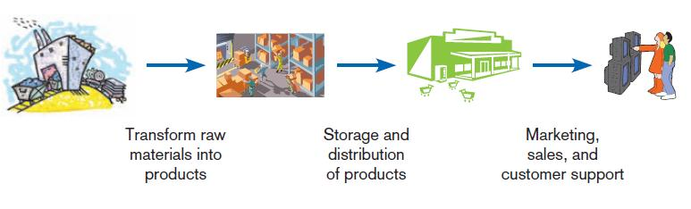
The Process of Identifying and Selecting IS Development Projects (Cont.)
FIGURE 4-2
Organizations can be thought of as a
value chain, transforming raw materials
into products for customers.
Chapter 4
Copyright © 2014 Pearson Education, Inc. Publishing as Prentice Hall

Slide 10
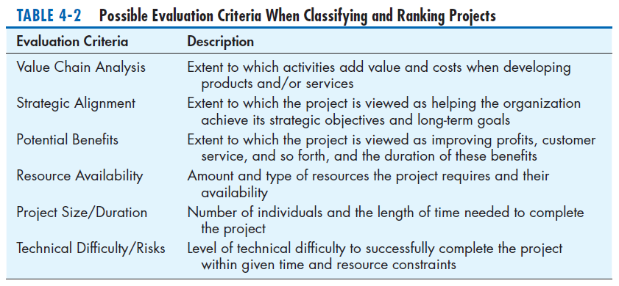
The Process of Identifying and Selecting IS Development Projects (Cont.)
Chapter 4
Copyright © 2014 Pearson Education, Inc. Publishing as Prentice Hall

Slide 11
The Process of Identifying and Selecting IS Development Projects (Cont.)
Selecting IS development projects
  Based on various factors
  Both short- and long-term projects considered
  Most likely to achieve business objectives selected
  A very important and ongoing activity
Chapter 4
Copyright © 2014 Pearson Education, Inc. Publishing as Prentice Hall

Slide 12
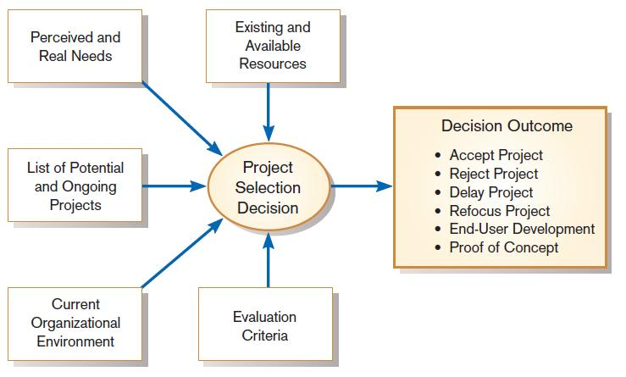
The Process of Identifying and Selecting IS Development Projects (Cont.)
FIGURE 4-3
Project selection decisions must consider numerous factors and can have numerous outcomes.
Chapter 4
Copyright © 2014 Pearson Education, Inc. Publishing as Prentice Hall

Slide 13
The Process of Identifying and Selecting IS Development Projects (Cont.)
One method for deciding among different projects or alternative designs:
  For each requirement or constraint:
  Score = weight X rating
  Each alternative: sum scores across requirements/constraints
  Alternative with highest score wins
Chapter 4
Copyright © 2014 Pearson Education, Inc. Publishing as Prentice Hall

Slide 14
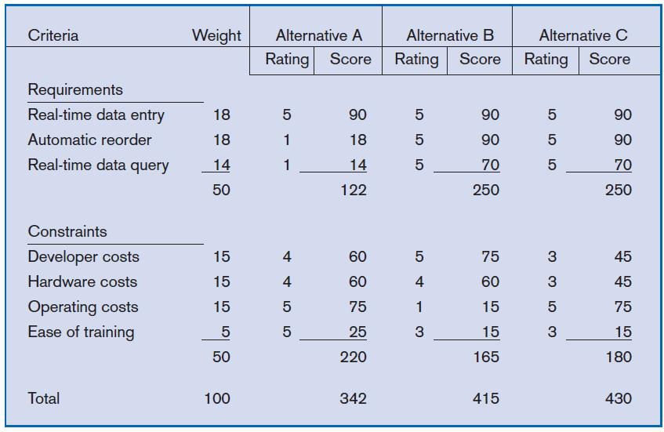
The Process of Identifying and Selecting IS Development Projects (Cont.)
FIGURE 4-4
Alternative projects and system design
decisions can be assisted using weighted
multicriteria analysis.
Chapter 4
Copyright © 2014 Pearson Education, Inc. Publishing as Prentice Hall

Slide 15
Deliverables and Outcomes
Primary deliverable from the first part of the planning phase is a schedule of specific IS development projects.
Outcome of the next part of the planning phase—project initiation and planning—is the assurance that careful consideration was given to project selection and each project can help the organization reach its goals.
Chapter 4
Copyright © 2014 Pearson Education, Inc. Publishing as Prentice Hall

Slide 16
Deliverables and Outcomes (Cont.)
Incremental commitment: a strategy in systems analysis and design in which the project is reviewed after each phase and continuation of the project is rejustified
Chapter 4
Copyright © 2014 Pearson Education, Inc. Publishing as Prentice Hall

Slide 17
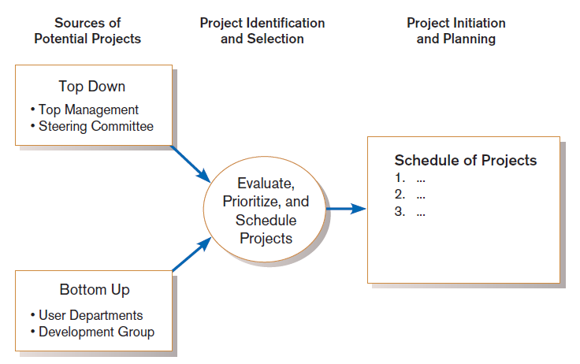
Deliverables and Outcomes (Cont.)
Figure 4-5
Information systems development projects come from both top-down and bottom-up initiatives.
Chapter 4
Copyright © 2014 Pearson Education, Inc. Publishing as Prentice Hall

Slide 18
Corporate and Information Systems Planning
To benefit from a planning-based approach for identifying and selecting projects, an organization must:
  Analyze its information needs thoroughly.
  Plan its projects carefully.
Chapter 4
Copyright © 2014 Pearson Education, Inc. Publishing as Prentice Hall

Slide 19
Reasons for Importance of Improved Planning
Increasing cost of information systems (40% of organizational expense)
Lack of cross-organizational applications and systems
Systems don’t address critical strategic problems
Too much data redundancy, lack of data quality
High system maintenance costs
Long application backlogs
Chapter 4
Copyright © 2014 Pearson Education, Inc. Publishing as Prentice Hall

Slide 20
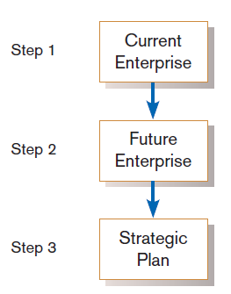
Corporate Strategic Planning
Ongoing process that defines mission, objectives, and strategies of an organization
Corporate strategy involves:
  Mission statement
  Objective statements
  Description of competitive strategy
Figure 4-6
Corporate strategic planning is a three step
Process.
Chapter 4
Copyright © 2014 Pearson Education, Inc. Publishing as Prentice Hall

Slide 21
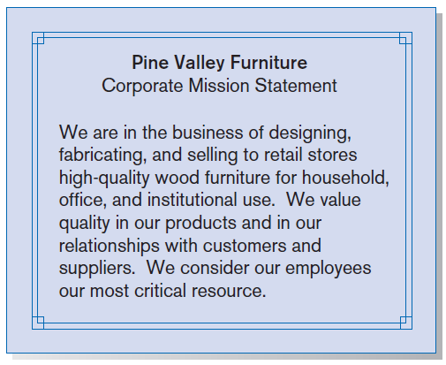
Corporate Strategic Planning (Cont.)
Mission statement: a statement that makes it clear what business a company is in
Figure 4-7
Mission statement (Pine Valley Furniture)
Chapter 4
Copyright © 2014 Pearson Education, Inc. Publishing as Prentice Hall

Slide 22
Corporate Strategic Planning (Cont.)
Objective statement: a series of statements that express an organization’s qualitative and quantitative goals for reaching a desired future position
Chapter 4
Copyright © 2014 Pearson Education, Inc. Publishing as Prentice Hall

Slide 23
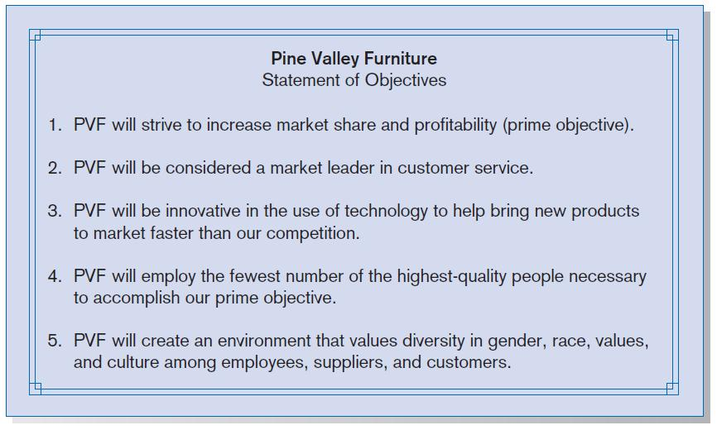
Corporate Strategic Planning (Cont.)
FIGURE 4-8
Statement of Corporate Objectives
(Pine Valley Furniture)
Chapter 4
Copyright © 2014 Pearson Education, Inc. Publishing as Prentice Hall

Slide 24
Corporate Strategic Planning (Cont.)
Competitive strategy: the method by which an organization attempts to achieve its mission and objectives
Main types:
  Low-cost producer
  Product differentiation
  Product focus or niche
Chapter 4
Copyright © 2014 Pearson Education, Inc. Publishing as Prentice Hall

Slide 25
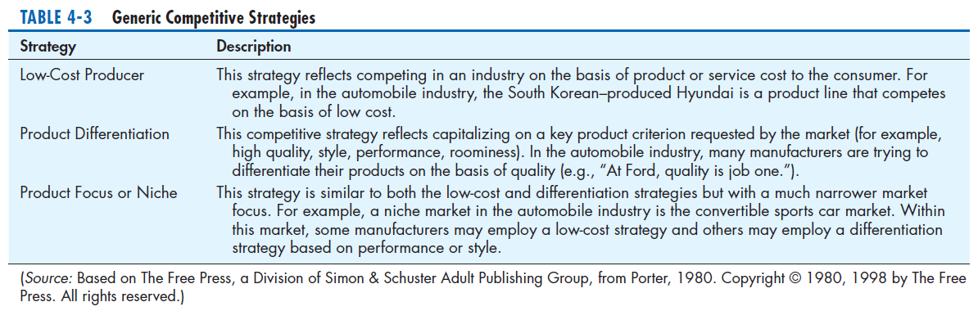
Corporate Strategic Planning (Cont.)
Chapter 4
Copyright © 2014 Pearson Education, Inc. Publishing as Prentice Hall

Slide 26
Information Systems Planning (ISP)
An orderly means of assessing the information needs of an organization and defining the systems, databases, and technologies that will best meet those needs
ISP must be done in accordance with the organization’s mission, objectives, and competitive strategy.
Chapter 4
Copyright © 2014 Pearson Education, Inc. Publishing as Prentice Hall

Slide 27
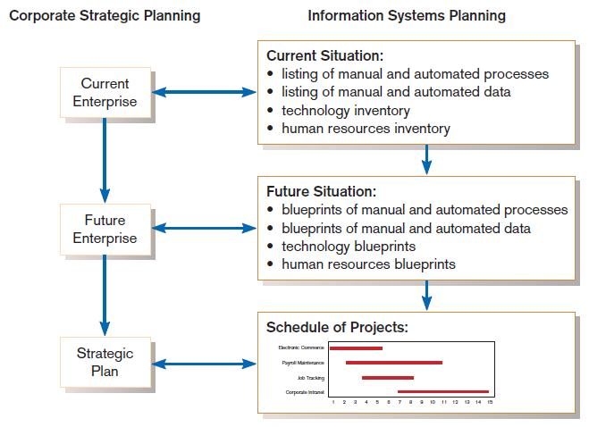
Information Systems Planning (Cont.)
FIGURE 4-10
Parallel activities of corporate strategic planning and information systems planning
Chapter 4
Copyright © 2014 Pearson Education, Inc. Publishing as Prentice Hall

Slide 28
Information Systems Planning (Cont.)
Top-down planning attempts to gain a broad understanding of information system needs of the entire organization and offers:
  Broader perspective.
  Improved integration.
  Improved management support.
  Better understanding.
Chapter 4
Copyright © 2014 Pearson Education, Inc. Publishing as Prentice Hall

Slide 29
Information Systems Planning (Cont.)
Bottom-up planning identifies IS development projects based on solving specific operational business problems or taking advantage of specific opportunities.
  Can be faster and less costly, so may be beneficial in certain circumstances.
Chapter 4
Copyright © 2014 Pearson Education, Inc. Publishing as Prentice Hall

Slide 30
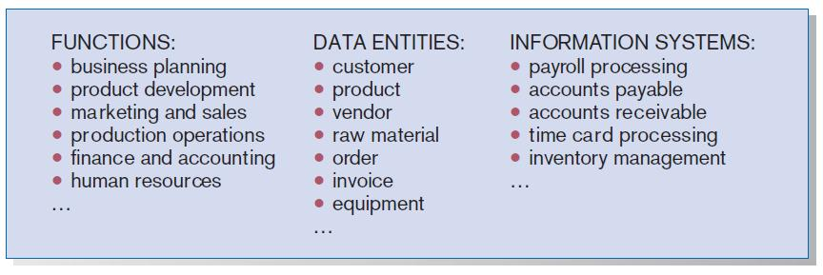
Information Systems Planning (Cont.)
FIGURE 4-11
Information systems planning information
(Pine Valley Furniture)
Chapter 4
Copyright © 2014 Pearson Education, Inc. Publishing as Prentice Hall

Slide 31
Information Systems Planning (Cont.)
Functional Decomposition: breaking high-level abstract information into smaller units for more detailed planning
Chapter 4
Copyright © 2014 Pearson Education, Inc. Publishing as Prentice Hall

Slide 32
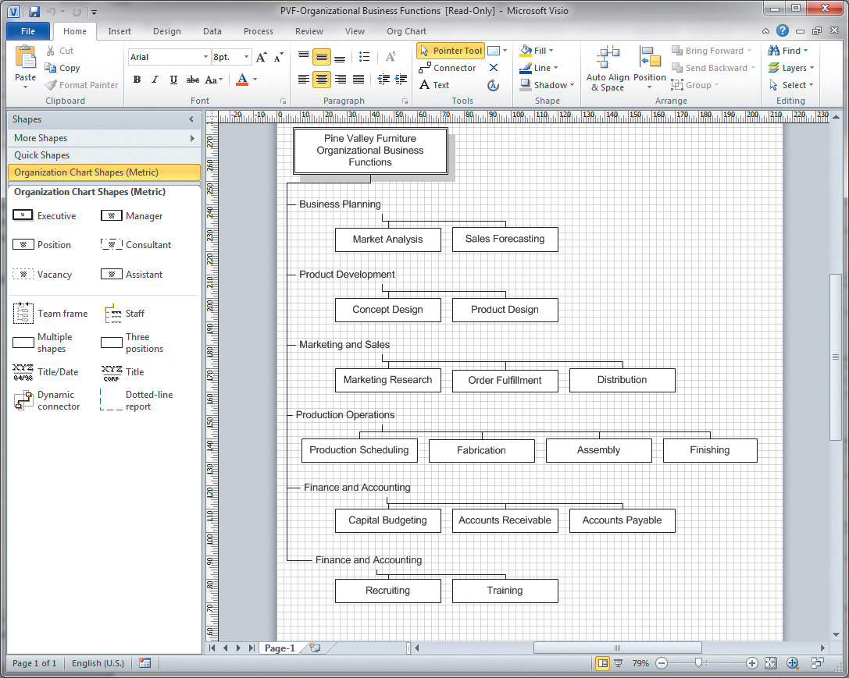
Information Systems Planning (Cont.)
FIGURE 4-12
Functional decomposition of information
systems planning information (Pine Valley Furniture)
(Source: Microsoft Corporation.)
Chapter 4
Copyright © 2014 Pearson Education, Inc. Publishing as Prentice Hall

Slide 33
Information Systems Planning (Cont.)
IS planning matrices describe relationships between pairs of organizational elements (location, function, business unit, objective, process, data, information system).
Chapter 4
Copyright © 2014 Pearson Education, Inc. Publishing as Prentice Hall

Slide 34
Types of Planning Matrices
Location-to-Function
Location-to-Unit
Unit-to-Function
Function-to-Objective
Function-to-Process
Function-to-Data Entity
Process-to-Data Entity
Process-to-Information System
Data Entity-to-Information System
Information System-to-Objective
Chapter 4
Copyright © 2014 Pearson Education, Inc. Publishing as Prentice Hall

Slide 35
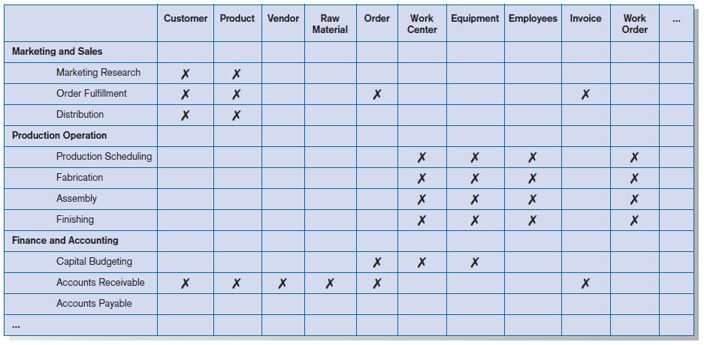
Information Systems Planning (Cont.)
FIGURE 4-13
Data Entity-to-Function matrix (Pine Valley Furniture)
Chapter 4
Copyright © 2014 Pearson Education, Inc. Publishing as Prentice Hall

Slide 36
IS Plan Components
Organizational Mission, Objectives, and Strategy
  Brief description of mission, objectives, and strategy of the organization
Information Inventory
  Summary of processes, functions, data entities, and information needs of the enterprise
Chapter 4
Copyright © 2014 Pearson Education, Inc. Publishing as Prentice Hall

Slide 37
IS Plan Components (Cont.)
Mission and Objectives of IS
  Primary role IS will play in the organization to transform enterprise from current to future state
Constraints on IS Development
  Limitations imposed by technology and current levels of financial, technical, and personnel resources
Chapter 4
Copyright © 2014 Pearson Education, Inc. Publishing as Prentice Hall

Slide 38
IS Plan Components (Cont.)
Systems Needs and IS Strategy
  Summarize overall information systems needs in the company and set long-term (2-5 year) strategies for filling the needs
Short Term Plan
  Detailed inventory of present projects and systems and detailed plan for the current year
Chapter 4
Copyright © 2014 Pearson Education, Inc. Publishing as Prentice Hall

Slide 39
IS Plan Components (Cont.)
Conclusions
  Unknown but likely events that can affect the plan, presently known business change elements and their impact on the plan
Chapter 4
Copyright © 2014 Pearson Education, Inc. Publishing as Prentice Hall

Slide 40
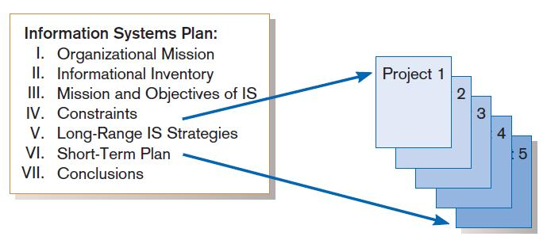
Information Systems (IS) Plan
FIGURE 4-16
Systems development projects flow from the information systems plan.
Chapter 4
Copyright © 2014 Pearson Education, Inc. Publishing as Prentice Hall

Slide 41
Electronic Commerce Applications and Internet Basics
Internet: a large worldwide network of networks that use a common protocol to communicate with each other
Electronic Commerce (EC): Internet-based communication to support day-to-day business activities
Business-to-consumer (B2C): electronic commerce between businesses and consumers
Chapter 4
Copyright © 2014 Pearson Education, Inc. Publishing as Prentice Hall

Slide 42
Electronic Commerce Applications and Internet Basics (Cont.)
Business-to-business (B2B): electronic commerce between business partners, such as suppliers and intermediaries
Business-to-employee (B2E): electronic commerce between businesses and their employees
Electronic data interchange (EDI): the use of telecommunications technologies to directly transfer business documents between organizations
Chapter 4
Copyright © 2014 Pearson Education, Inc. Publishing as Prentice Hall

Slide 43
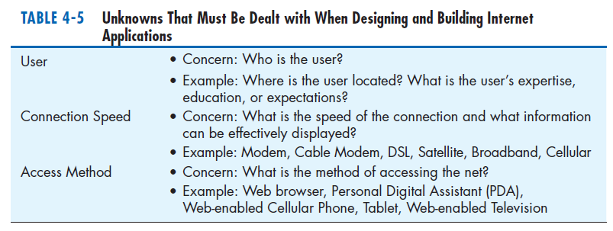
Electronic Commerce Applications and Internet Basics (Cont.)
Chapter 4
Copyright © 2014 Pearson Education, Inc. Publishing as Prentice Hall

Slide 44
Summary
In this chapter you learned how to:
  Describe the project identification and selection process.
  Describe corporate strategic planning and information systems planning.
  Explain the relationship between corporate strategic planning and IS planning.
Chapter 4
Copyright © 2014 Pearson Education, Inc. Publishing as Prentice Hall

Slide 45
Summary (Cont.)
  Describe how IS planning can assist in system development project identification and selection.
  Analyze IS planning matrices.
  Describe three classes of E-Commerce applications.
Chapter 4
Copyright © 2014 Pearson Education, Inc. Publishing as Prentice Hall

